Slide 1
CSC410 - Professional Practices in IT
Instructor Name : Sidra Nasir

Slide 2
Today Topics
Protections for Software
Open-Source Software
Legitimacy of Intellectual Property Protection for Software
Creative Commons

Slide 3
Protections for Software

Slide 4
Software Copyrights
Copyright protection began 1964
What gets copyrighted?
– Expression of idea, not idea itself
– Object program, not source program
Companies treat source code as a trade secret

Slide 5
Violations of Software Copyrights
Copying a program to give or sell to someone else
Preloading a program onto the hard disk of a computer being sold
Distributing a program over the Internet

Slide 6
Important Court Cases
Apple Computer v. Franklin Computer
– Established that object programs are copyrightable
Sega v. Accolate
– Established that disassembling object code to determine technical specifications is fair use

Slide 7
Safe Software Development
Reverse engineering okay
Companies must protect against unconscious copying
Solution: “clean room” software development strategy
– Team 1 analyzes competitor’s program and writes specification
– Team 2 uses specification to develop software

Slide 8
Software Patents (1/3)
Until 1981, Patent Office refused to grant software patents
– Saw programs as mathematical algorithms, not processes or machines
U.S. Supreme Court decision led to first software patent in 1981
Further court rulings led to patents being granted for wider range of software

Slide 9
Software Patents (2/3)
Thousands of software patents now exist
– Microsoft files ~3,000 applications annually
– Licensing patents a source of revenue
• Secondary market for software patents
– Patent trolls: Companies that specialize in buying patents and enforcing patent rights
– Companies would rather settle out of court than spend time and money going to trial
– RIM didn’t settle quickly; ended up paying $612 million

Slide 10
Software Patents (3/3)
Critics say too many patents have been issued
– Patent Office doesn’t know about prior art, so it issues bad software patents
– Obvious inventions get patents
Companies with new products fear getting sued for patent infringement
– Build stockpiles of patents as defense mechanism
– Software patents used as legal weapons • Bezos: software patents should expire in 3-5 years

Slide 11
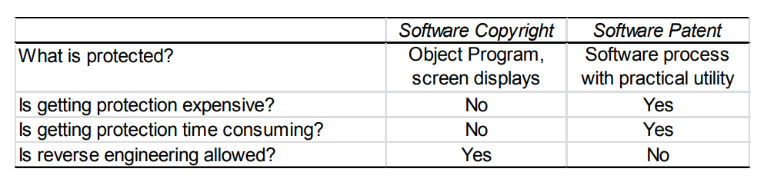
Key Differences between Software Copyrights and Software Patents

Slide 12
Open-Source Software

Slide 13
Criticisms of Proprietary Software
Increasingly harsh measures being taken to enforce copyrights
Copyrights are not serving their purpose of promoting progress
It is wrong to allow someone to “own” a piece of intellectual property

Slide 14
Open-Source Definition
No restrictions preventing others from selling or giving away software
•Source code included in distribution
No restrictions preventing others from modifying source code
No restrictions regarding how people can use software
Same rights apply to everyone receiving redistributions of the software (copyleft)

Slide 15
Beneficial Consequences of OpenSource Software
Gives everyone opportunity to improve program
New versions of programs appear more frequently
Eliminates tension between obeying law and helping others
Programs belong to entire community
Shifts focus from manufacturing to service

Slide 16
Examples of Open-Source Software
BIND
Apache
Sendmail
Android operating system for smartphones
Firefox and Chrome • OpenOffice.org
Perl, Python, Ruby, TCL/TK, PHP, Zope
GNU compilers for C, C++, Objective-C, Fortran, Java, and Ada

Slide 17
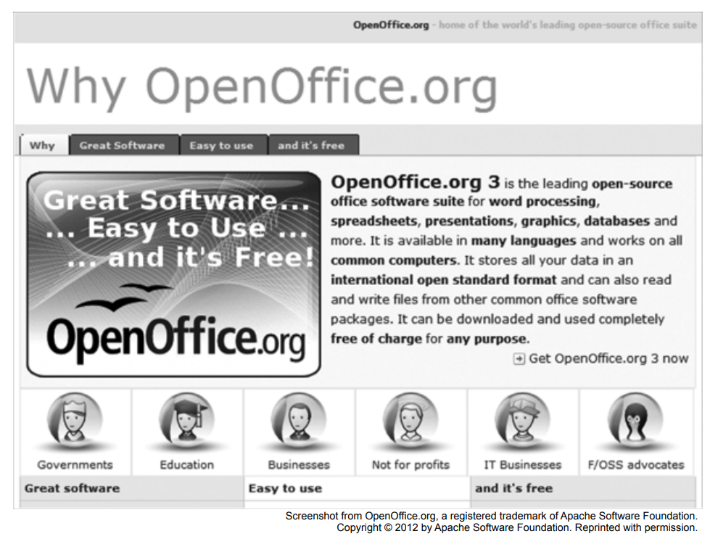

Slide 18
GNU Project and Linux
GNU Project
– Begun by Richard Stallman in 1984
– Goal: Develop open-source, Unix-like operating system
– Most components developed in late 1980s
Linux – Linus Torvalds wrote Unix-like kernel in 1991
– Combined with GNU components to make an O.S.
– Commonly called Linux

Slide 19
Impact of Open-Source Software
Linux an alternative to proprietary versions of Unix
Linux operating system on 95% of the world’s 500 fastest supercomputers

Slide 20
Crititique of the Open-Source Software Movement
Without critical mass of developers, quality can be poor
Without an “owner,” incompatible versions may arise
Relatively weak graphical user interface
Poor mechanism for stimulating innovation (no companies will spend billions on new programs)

Slide 21
Legitimacy of Intellectual Property Protection for Software

Slide 22
Do We Have the Right System in Place?
Software licenses typically prevent you from making copies of software to sell or give away
Software licenses are legal agreements
Not discussing morality of breaking the law
Discussing whether society should give intellectual property protection to software

Slide 23
Rights-based Analysis
“Just deserts” argument
– Programming is hard work that only a few can do
– Programmers should be rewarded for their labor
– They ought to be able to own their programs
Criticism of “just deserts” argument
– Why does labor imply ownership?
– Can imagine a just society in which all labor went to common good – Intellectual property not like physical property

Slide 24
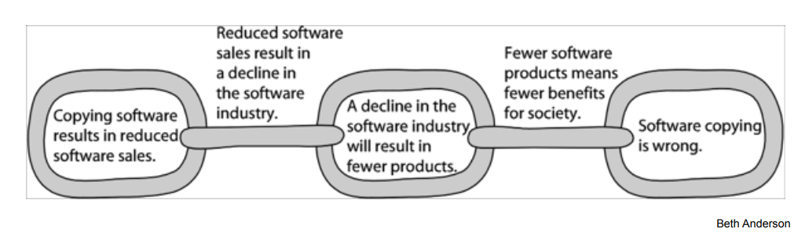
A Consequentialist Argument Why Software Copying Is Bad

Slide 25
Utilitarian Analysis
Argument against copying
– Copying software reduces software purchases…
– Leading to less income for software makers…
– Leading to lower production of new software…
– Leading to fewer benefits to society
Each of these claims can be debated
– Not all who get free copies can afford to buy software
– Open-source movement demonstrates many people are
willing to donate their software-writing skills
– Hardware industry wants to stimulate software industry
– Difficult to quantify how much society would be harmed if certain software packages not released

Slide 26
Conclusion
Natural rights argument weak
Utilitarian argument not strong, either
Nevertheless, society has granted copyright protection to owners of computer programs
Breaking the law is wrong unless there is a strong overriding moral obligation or consequence

Slide 27
Creative Commons

Slide 28
Streamlining Creative Re-use
Under current copyright law, eligible works are copyrighted the moment they are created
No copyright notice does not mean it’s okay to copy
Must contact people before using work
That slows down creative re-use
Free Creative Commons license indicates
– Which kinds of copying are okay
– Which rights are being retained
Flickr and Magnatune two well-known sites using Creative Commons licenses

Slide 29
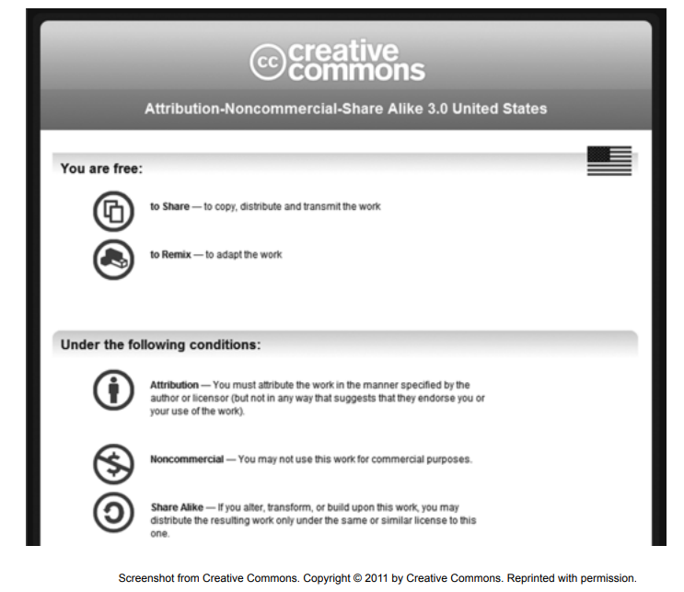

Slide 30
End of Lecture

